Slide 1
Method of Hyperparameter Optimization of a Genetic Algorithm applied in Critical Scenario Generation for Autonomous Vehicles Master‘s Thesis Presentation

Slide 2
Introduction
Method for critical traffic scenario generation
Can be used to validate safety of autonomous driving systems
Implementation:
Autonomous driving functionality is applied on the EGO vehicle
Genetic Algorithm optimizes the criticality of the traffic scenario
Controls all other vehicles and pedestrians (NPCs) in the simulation
The Cumulated Emergency Brake Duration of the EGO vehicle serves as the criticality measure

Slide 3
Research Questions
Q1: Is a genetic algorithm suitable for generating critical driving scenarios compared to random search?
Q2: Can the performance of a genetic algorithm be improved by optimizing the control parameter using the Taguchi method?

Slide 4
Simulation Setup
Traffic Manger provides a traffic simulation
Vehicles and pedestrians move through the simulation in a realistic manner
Provides an interface to alter individual actor behaviour through actions
Example actions: LaneChange, JunctionSelection, ModifyTargetVelocity, CrossRoad, etc …
Genetic Algorithm optimizes the fitness function by directing NPCs through actions
Traffic Manger
Genetic Algorithm
Fitness
Action Interface
NPC 1
NPC 2
NPC 3
…
Visualization of simulation setup

Slide 5
Genetic Algorithm [Holland 1975]
Search algorithm inspired by the process of natural selection
Can efficiently navigate large search spaces
Population-Based Optimization:
Operates on a population of individuals
Individuals evolve over multiple generations
Best individuals reproduce using crossover and mutation operations
One individual consist of one chromosome
One chromosome consists of a list of genes
One chromosome describes one solution to the search problem
Usually needs a custom encoding
Two different encoding were designed to contain the actions for all NPCs for a whole simulation

Slide 6



Genetic Algorithm: Chromosome Action Sequence
0
1
2
3
4
5
6
7
8
9
10
11
12
13
14
15
16
17
18
19
ModifyTargetVelocity(10%)
ModifyTargetVelocity(160%)
LaneChange(left)
LaneChange(right)
noAction()
Animation describing a simple action sequence of one NPC encoded into a chromosome
Notes:
Only one npc.
One gene represent one action.
The gene order corresponds the time steps of when the action is set.
No action is taken, so npc should continue on current trajectory

Slide 7
Genetic Algorithm: Crossover Operation
Two Point Crossover
0
1
2
3
4
5
6
7
8
9
10
11
12
13
14
15
16
17
18
19
0
1
2
3
4
5
6
7
8
9
10
11
12
13
14
15
16
17
18
19
+ Keeps sequences mostly intact
- Might struggle to maintain diversity
Notes:
The fitness function will select 2 good performing individuals to reproduce using a crossover operation.
The resulting offspring will the move on into the next generation
Often not enough change introduced….

Slide 8
Genetic Algorithm: Crossover Operation
50% Uniform Crossover
0
1
2
3
4
5
6
7
8
9
10
11
12
13
14
15
16
17
18
19
0
1
2
3
4
5
6
7
8
9
10
11
12
13
14
15
16
17
18
19
+ Keeps diversity high
- Disruptive to sequences

Slide 9
Hyperparameter Tuning
Literature review
Recommended hyperparameter combinations gathered from existing literature
32 different hyperparameter combinations tested over 5 repetitions
Taguchi Method
Developed by Genichi Taguchi for robust optimization [Roy 1990]
Part of Design of Experiment
Systematic approach for process optimization
Identifies factors (i.e., hyperparameters) impacting performance
Identifies optimal factor-level (i.e., setting for each hyperparameter) combination
Advantages of Taguchi Method:
Simple procedure for minimizing the number of experiment runs
Predefined interactions between factors can be analyzed

Slide 10
Hyperparameter Tuning: Taguchi Method
Required 16 experiment runs, to optimize
Three 4-level factors
Four 2-level factors
and investigate one interaction between two factors
Each run was repeated 8 times
Results showed that the most significant hyperparameters are
Selection Method
Crossover Type
Mutation Probability
Notes:
Three hyperparameters, each having 4 possible settings

Slide 11
Hyperparameter Tuning: Comparison
Hyperparameter Combinations
Settings | Literature Review | Taguchi Method
Number of Generations | 30 | 30
Population Size | 96 | 96
Crossover Type | Two Point | Uniform 50%
Crossover Probability | 80% | 90%
Mutation Probability | 20% | 30%
Table showing resulting hyperparameter settings from both optimization methods
Notes:
High disruptiveness in all hyperparameter combinations, but especially in the combination recommended by the Taguchi method

Slide 12
Evaluation
Comparison between:
Optimized Genetic Algorithm – uses the resulting settings from the Taguchi method
Default Genetic Algorithm – uses best settings from the literature review
Random Search
Each algorithm was tested on
4 different start scenarios
Each experiment repeated 10 times

Slide 13
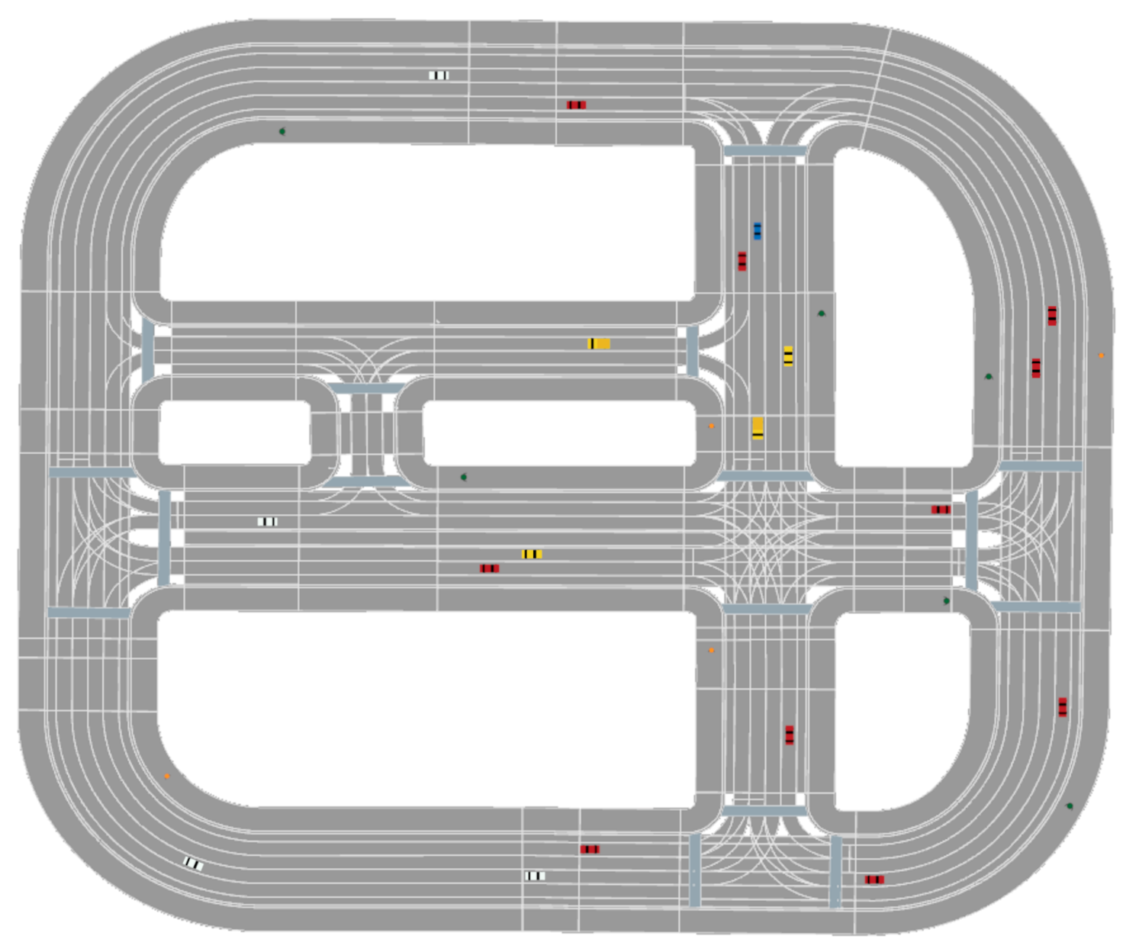
Evaluation: Start Scenario Map
19 Vehicles
10 Pedestrians
Road map with initial positions of vehicles and pedestrians

Slide 14
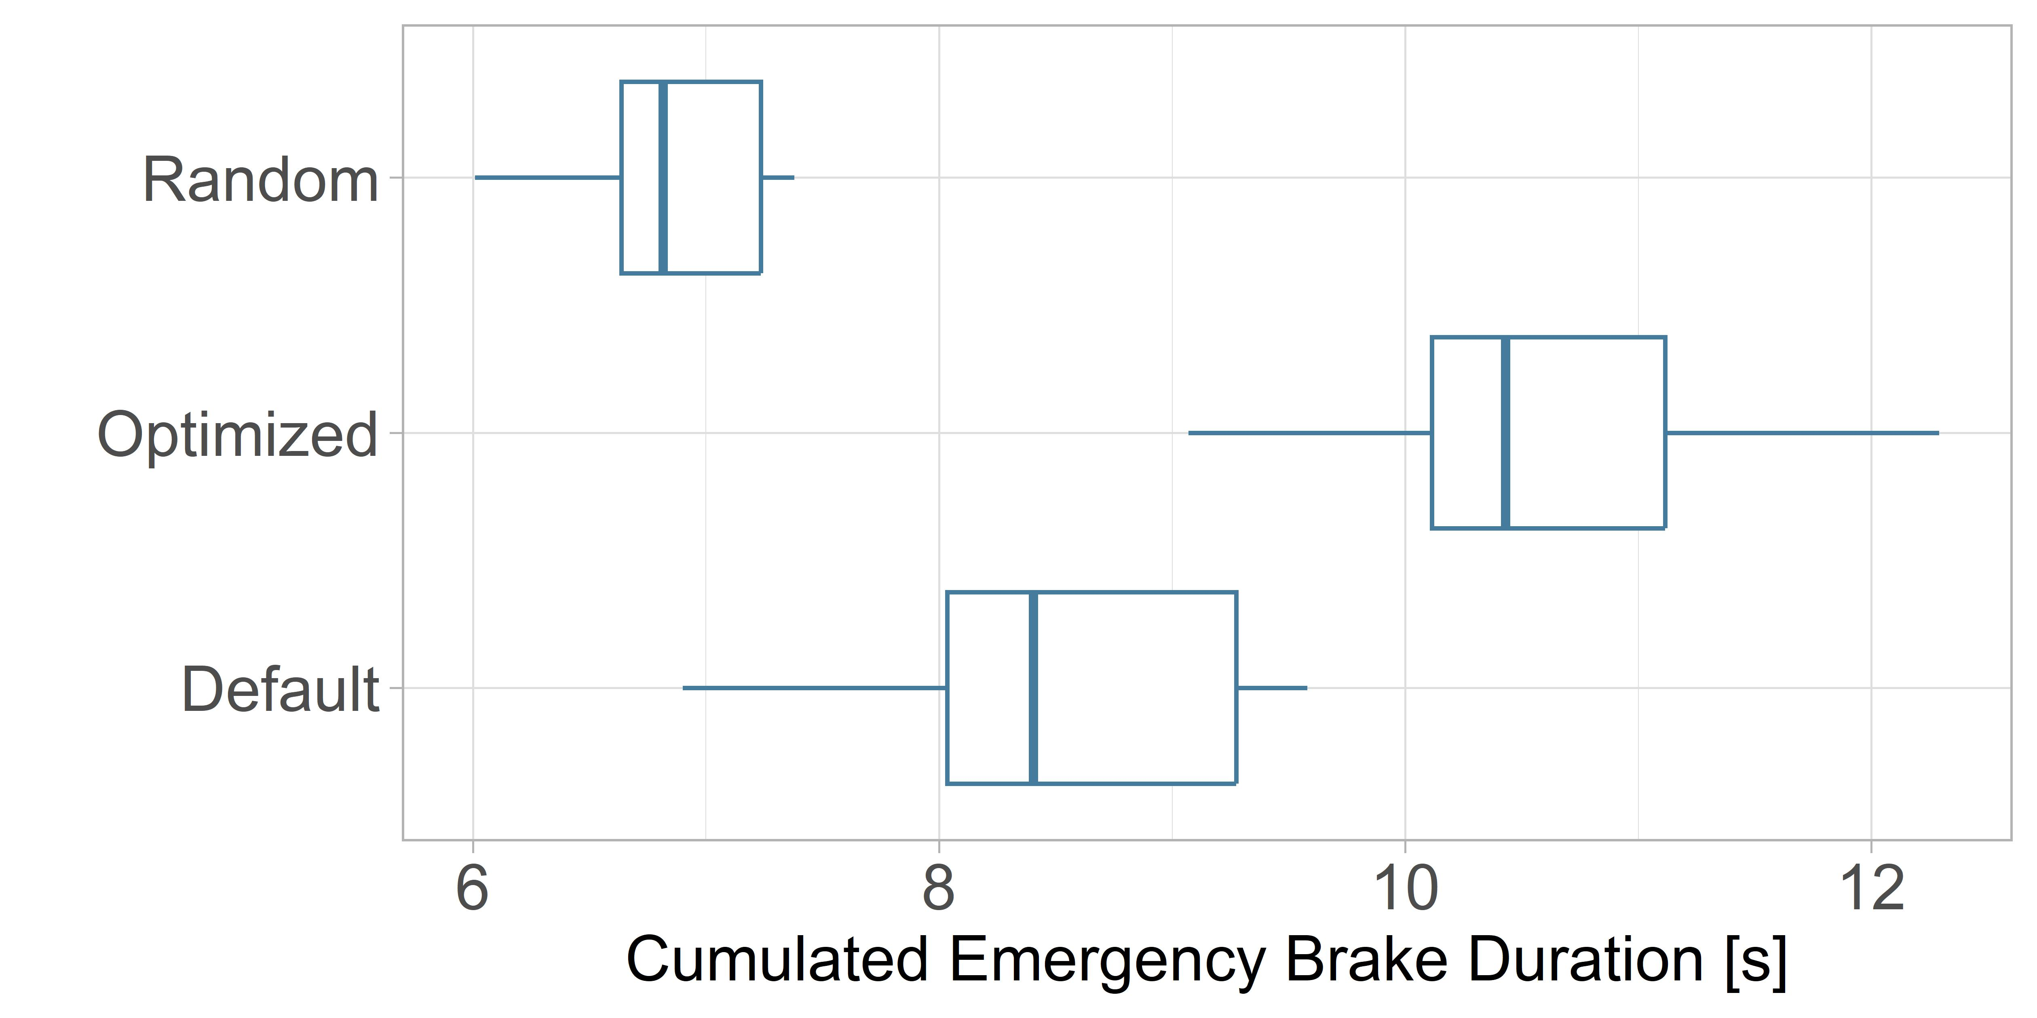
Evaluation: Results
Boxplots of evaluation results over ten repetitions
Notes:
Better text, better graphs

Slide 15
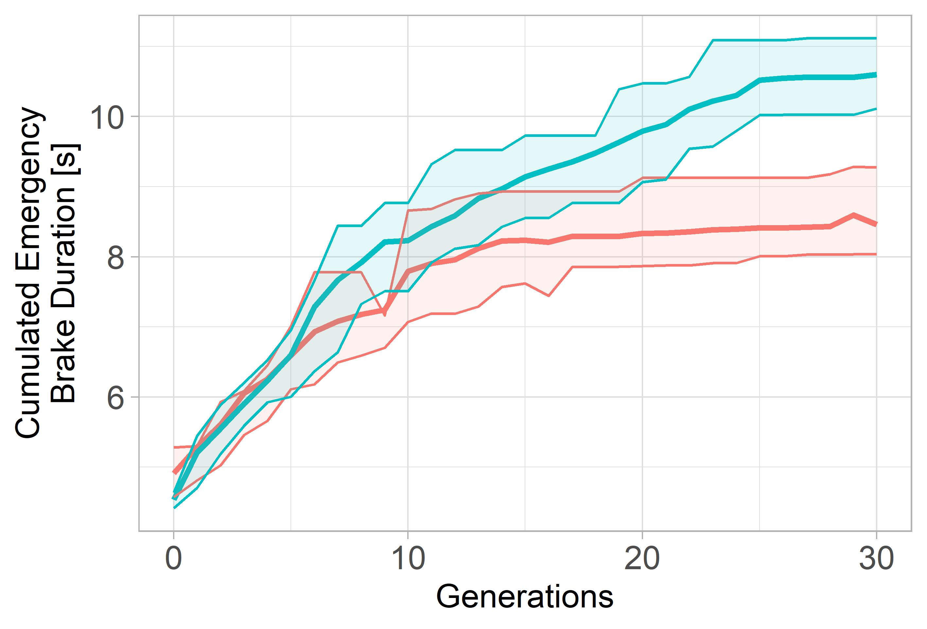
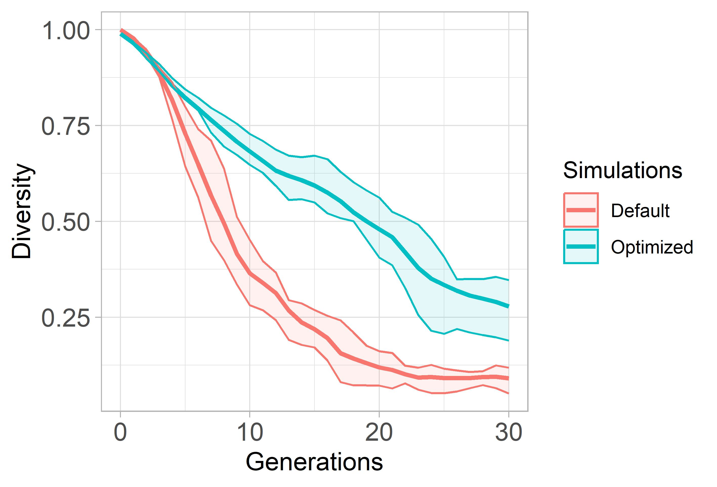
Evaluation: Genetic Algorithm Comparison
Graph showing fitness per generation over ten repetitions
Graph showing diversity per generation over ten repetitions
Notes:
Stops being able to increase his fitness value
Converges
Continue increasing its performance
Diversity quickly drops for default alg, which means that default is not able to have enough information in the population to continue expoliriing the search space
Can be contributed to the high disruptiveness of the optimized settings, which, meant that it is much more robust at avoiding local minimas.

Slide 16
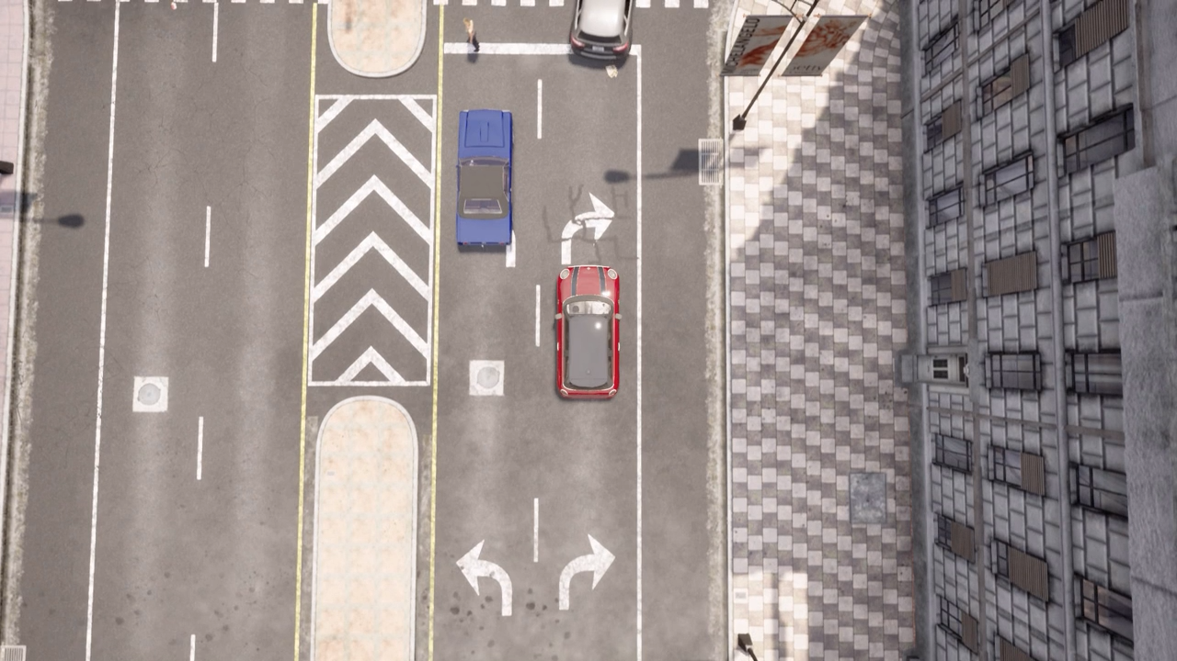

Critical Situation 1
Critical Situation after pedestrian crossing
NPC vehicle violates path of EGO vehicle
EGO vehicle has to emergency break
Situation generated using Optimized Genetic Algorithm and rendered using CARLA Simulator (https://github.com/carla-simulator/carla)

Slide 17
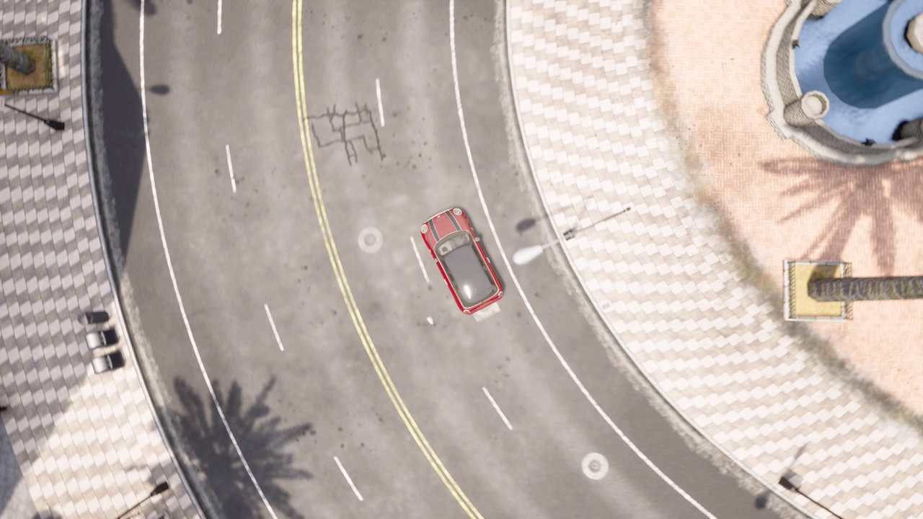

Critical Situation 2
Critical Situation inside junction
NPC vehicle ignores right of way
EGO vehicle has to emergency break
Situation generated using Optimized Genetic Algorithm and rendered using CARLA Simulator (https://github.com/carla-simulator/carla)

Slide 18


Critical Situation 3
Kid is occluded by Truck and runs over road
EGO vehicle has to emergency break
Situation generated using Optimized Genetic Algorithm and rendered using CARLA Simulator (https://github.com/carla-simulator/carla)

Slide 19
Thank You!

Slide 20
Bibliography
John H. Holland (1975). Adaptation in Natural and Artificial Systems: An Introductory Analysis with Applications to Biology, Control, and Artificial Intelligence. ISBN: 978-0-262-27555-2
Ranjit K. Roy (1990). A primer on the Taguchi method. ISBN: 978-0-442-23729-5

Slide 21
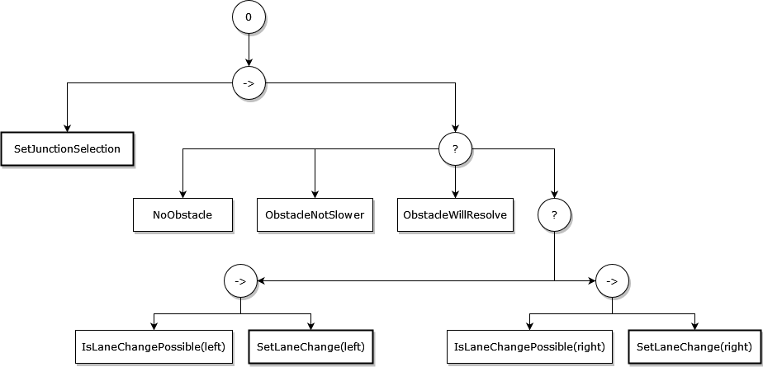
Additional Slides - Behaviour Tree
Behaviour Tree implementation for the EGO vehicle

Slide 22
Additional Slides - Chromosome encodings
Time Encoding
0
1
2
3
4
5
6
7
8
9
10
11
12
13
14
15
16
17
18
19
Corresponds to timestep 1 (0.5 seconds)
Action NPC 1
Action NPC 2
…
Action NPC n
Time+NPC Encoding
NPC 1
NPC 2
NPC 3
0
1
2
3
4
5
6
7
8
9
0
1
2
3
4
5
6
7
8
9
0
1
2
3
4
5
6
7
8
9
Corresponds to timestep 1 (0.5 seconds)
Action NPC 1

Slide 23
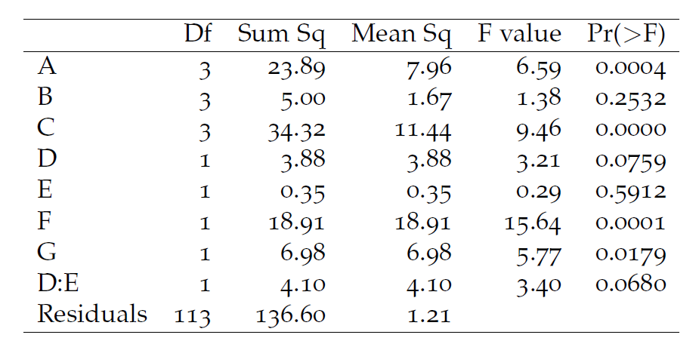
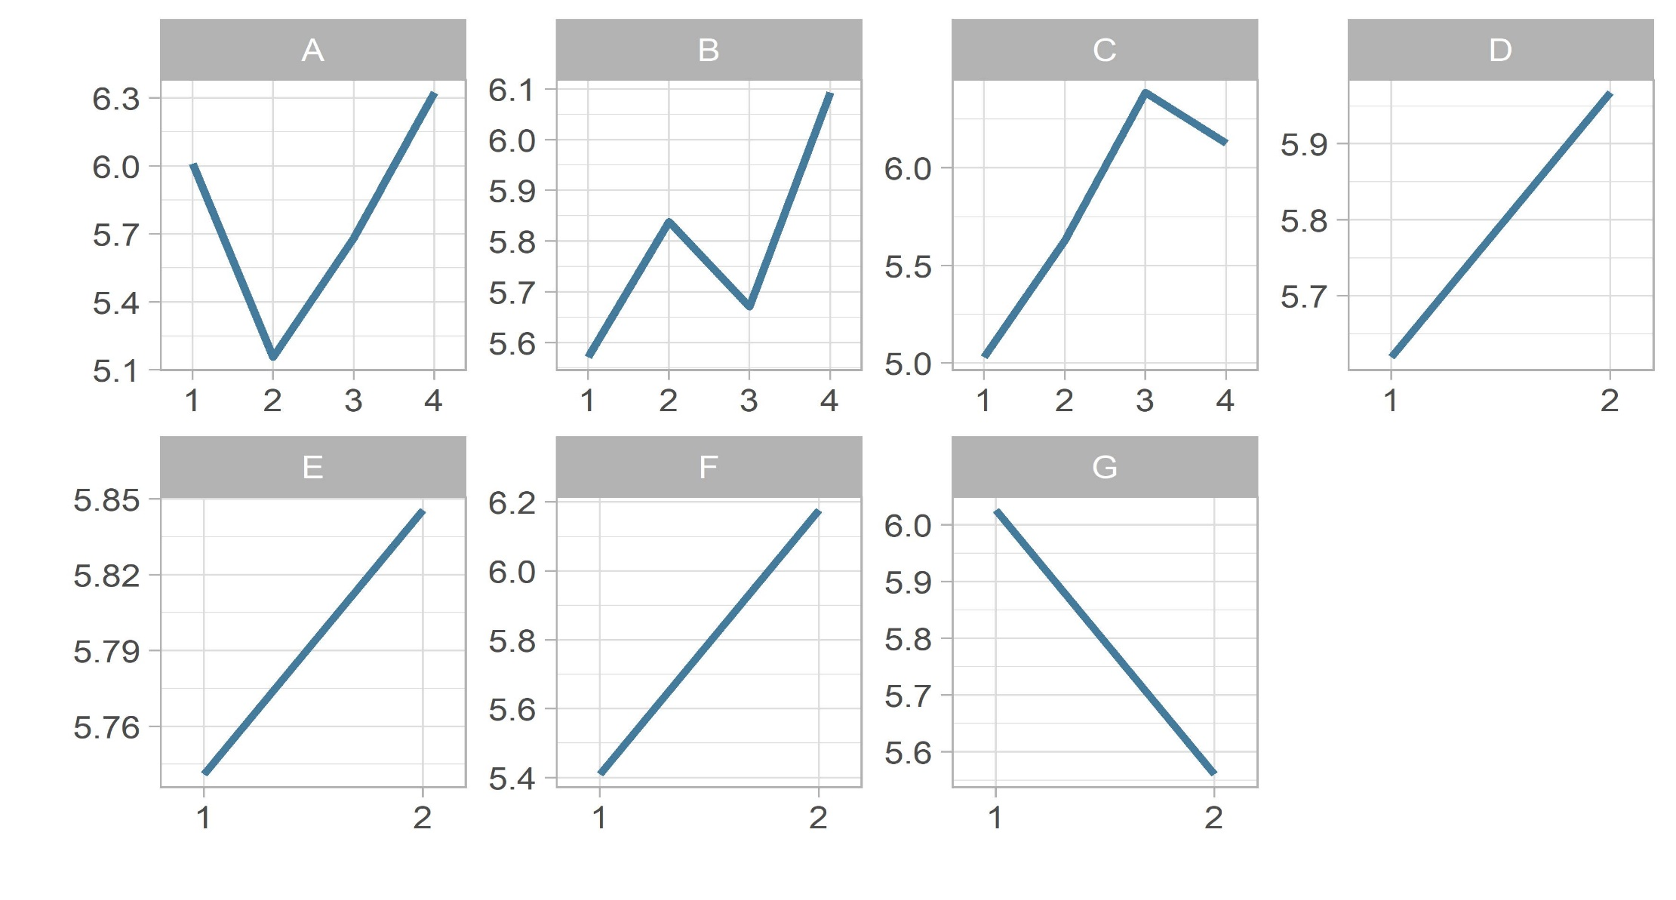
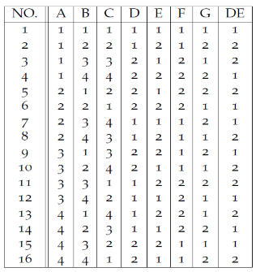
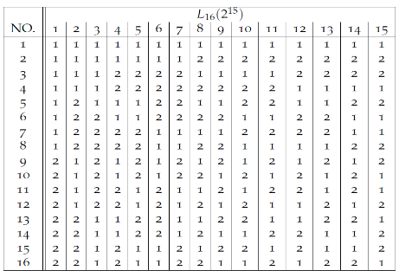
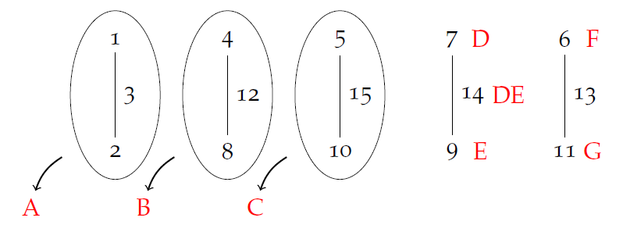
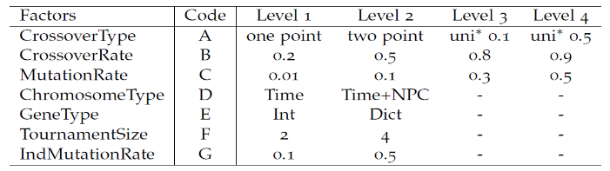
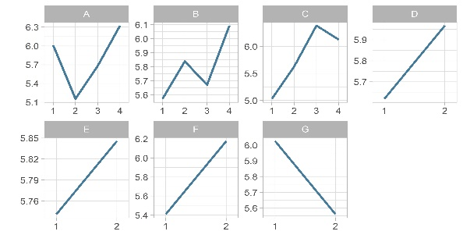
Additional Slides – Taguchi Method Animation
Factor and Level Selection
L₁₆ orthogonal array
Linear Graph
Run experiment using modified L₁₆ array
ANOVA
Main Effects

